Slide 1

REAL TIME IMAGE SEGMENTATION FOR SELF DRIVING CARS
Under the guidance of
GUIDE NAME AND DEGREE.,
by
D.BHEEMASHANKARRAHUL
(39110286)
KARTHIK SURAM
(39110991)

Slide 2
Presentation Outline
Introduction
Motivation
Literature survey
Inferences from Literature Survey
Objectives
System Architecture
Description of Software for Implementation
Project Management Plan
References
Q&A

Slide 3
Introduction
The initiative is based on self-driving automobiles, or autonomous driving.
Such an application is required in autonomous driving, where self-driving vehicles must comprehend their surroundings, such as other automobiles, pedestrians, road lanes, traffic signs, or traffic lights.
We also know that the immense success of deep learning has had a significant influence on semantic segmentation approaches, enhancing their accuracy.
A self-driving car must react rapidly to new occurrences in order to ensure the safety of passengers and other road users, however it is generally acceptable if object borders are not identified accurately down to a pixel resolution.

Slide 4
Motivation
Greater road safety
higher levels of autonomy have the potential to reduce risky and dangerous
Driver behaviours. The greatest promise may be reducing the devastation of impaired
Driving ,drugged driving ,unbelted vehicle occupants, speeding and distraction.
Greater independence
These vehicles can also enhance independence for senior.
More Productivity
In a fully automated vehicle , all occupants could safely pursue more productive or entertaining activities , like responding to email or watching a movie.

Slide 5
Abstract
The initiative is based on self-driving automobiles, or autonomous driving.
Such an application is required in autonomous driving, where self-driving vehicles must comprehend their surroundings, such as other automobiles, pedestrians, road lanes, traffic signs, or traffic lights.
We also know that the immense success of deep learning has had a significant influence on semantic segmentation approaches, enhancing their accuracy.
A self-driving car must react rapidly to new occurrences in order to ensure the safety of passengers and other road users, however it is generally acceptable if object borders are not identified accurately down to a pixel resolution.

Slide 6
Literature Review
Sno. | Paper title | Author | Algorithm | Accuracy | year | Disadvantage/ future work
1 | Traffic Light Detection and Recognition for Self Driving Cars Using Deep Learning | Ruturaj Kulkarni, Shruti Dhavalikar, Sonal Bangar, | Region-Based Convolutional Network | 87 | 2019 | There is more effective object detection algorithm is available
2 | Robust Target Recognition and Tracking of Self-Driving Cars With Radar and Camera Information Fusion Under Severe Weather Conditions | Ze Liu, Yingfeng Cai, Hai Wang, Long Chen, Hongbo Gao, Yunyi Jia, Yicheng Li | Information Fusion Sensing Systems | 89 | 2022 | Verification is not properly Guided
3 | RRPN: Radar Region Proposal Network for Object Detection in Autonomous Vehicles | Ramin Nabati, Hairong Qi | RRPN-Fast R-CNN | 92 | 2019 | There is more effective object detection algorithm is available
4 | Deep CNN-Based Real-Time Traffic Light Detector for Self-Driving Vehicles | Zhenchao Ouyang, Jianwei Niu, Yu Liu, Mohsen Guizani | Deep CNN | 86 | 2020 | Data redency is more

Slide 7
Literature Review
Sno. | Paper title | Author | Algorithm | Accuracy | Year | Disadvantage/ future work
5 | Autonomous Car Parking System using Deep Reinforcement Learning | Rikuya Takehara, Tad Gonsalves | Deep Learning | 91 | 2021 | Less sensor operation leads to lack of accuracy
6 | Deep Convolutional Neural Networks for Scene Understanding: A Study of Semantic Segmentation Models | Malvi Mungalpara, Priyanka Goradia, Trisha Baldha, Yanvi Soni | Deep Convolutional Neural Networks | 90 | 2022 | semantic segmentation operation is only performed for test sample
7 | Unstructured Road Detection and Steering Assist Based on HSV Color Space Segmentation for Autonomous Car | A.A. Mahersatillah, Z. Zainuddin, Y. Yusran | Hough transform | 86 | 2021 | edge detector usage make it costly
8 | Just Drive’: Colour Bias Mitigation for Semantic Segmentation in the Context of Urban Driving | Jack Stelling, Amir Atapour-Abarghouei | Semantic Segmentation | 89 | 2022 | Wrong Color imitation leads to miscalculation

Slide 8
Inferences from Literature Survey
From the above-mentioned literature works, it is clear that there has been effective research Real time image segmentation system has been done and many models have been proposed.
It is evident that the above-mentioned systems have their own pros and cons.
While some of the recent works involve hybrid technologies and provide better accuracies, they are still far from what is needed.
With higher accuracy, comes the need for low computational costs, high processing speed, and most of all, the convenience of use.

Slide 9
Objectives
Aim
The following are the primary goals of this study:
To provide a comprehensive list of the most efficient ways for developing real-time semantic segmentation models.
To attain great accuracy while yet having a short latency.
To current difficulties and developments in the field of real-time semantic picture segmentation that result in crucial discoveries.
in semantic picture segmentation models to gain a faster response time
Scope
The job of allocating each pixel of an image to a corresponding class label from a specified set of categories is known as image segmentation. Such an application is required in autonomous driving, where self-driving vehicles must comprehend their surroundings, such as other automobiles, pedestrians, road lanes, traffic signs, or traffic lights.

Slide 10
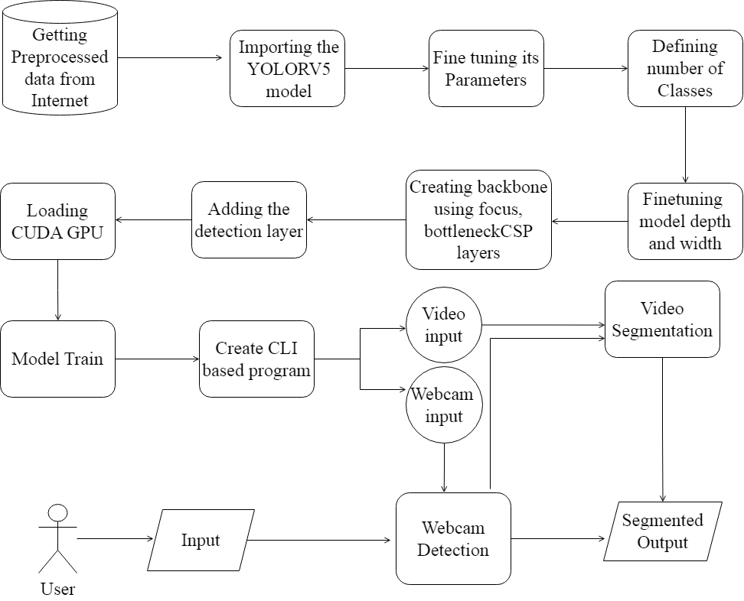
System Architecture

Slide 11
Description of Software for Implementation
Hardware specifications:
Microsoft Server enabled computers, preferably workstations
Higher RAM, of about 4GB or above
Processor of frequency 1.5GHz or above
Software specifications:
Python 3.6 and higher
Anaconda software

Slide 12
Project Management Plan
Introduction of the project
September 1-30
Literature Survey on project
October 1-31
System Design
November 1- 31
System Implementation
December 1-30
Testing
January 1-31
Conclusion
February 1-28

Slide 13
References
[1] Sneha.C. Madre, S.B. Gundre, “OCR Based Image Text to Speech Conversion Using MATLAB”, Second International Conference on Intelligent Computing and Control Systems (ICICCS), 2019
[2] P Rohit, M S Vinay Prasad, S J Ranganatha Gowda, D R Krishna Raju, Imran Quadri, “Image Recognition Based Smart Aid For Visually Challenged People”, International Conference on Communication and Electronics Systems (ICCES), 2020
[3] Sujata Deshmukh, Praditi Rede, Sheetal Sharma, Sahaana Iyer, “Voice-Enabled Vision For The Visually Disabled”, International Conference on Advances in Computing, Communication, and Control (ICAC3), 2022
[4] Sai Aishwarya Edupuganti, Vijaya Durga Koganti, Cheekati Sri Lakshmi, Ravuri Naveen Kumar, Ramya Paruchuri, “Text and Speech Recognition for Visually Impaired People using Google Vision”, 2nd International Conference on Smart Electronics and Communication (ICOSEC), 2021

Slide 14
References
[5] Abhishek Mathur, Akshada Pathare, Prerna Sharma, Sujata Oak, “AI based Reading System for Blind using OCR”, 3rd International conference on Electronics, Communication and Aerospace Technology (ICECA), 2019
[6] Vaibhav V. Mainkar, Tejashree U. Bagayatkar, Siddhesh K. Shetye, Hrushikesh R. Tamhankar, Rahul G. Jadhav, Rahul S. Tendolkar, “Raspberry pi based Intelligent Reader for Visually Impaired Persons”, 2nd International Conference on Innovative Mechanisms for Industry Applications (ICIMIA), 2020
[7] Javavrinda Vrindavanam, Raghunandan Srinath, Anisa Fathima, S. Arpitha, Chaitanya S Rao, T. Kavya, “Machine Learning based approach to Image Description for the Visually Impaired”, Asian Conference on Innovation in Technology (ASIANCON), 2021
[8] R. Prabha, M. Razmah, G. Saritha, RM Asha, Senthil G. A, R. Gayathiri, “Vivoice - Reading Assistant for the Blind using OCR and TTS”, International Conference on Computer Communication and Informatics (ICCCI), 2022
[9] S. Durgadevi, K. Thirupurasundari, C. Komathi, S.Mithun Balaji, “Smart Machine Learning System for Blind Assistance”, International Conference on Power, Energy, Control and Transmission Systems (ICPECTS), 2021
[10] Sandeep Musale, Vikram Ghiye, “Smart reader for visually impaired”, 2nd International Conference on Inventive Systems and Control (ICISC), 2018

Slide 15
THANK YOU
We thank our guide and panel and all technical and non technical staff helped us in achieving this.

